Slide 1


AMAZON SALE ANALYSIS
Sunil singh baist

Slide 2
Objective :-
Sales management has gained importance to meet increasing competition and the need for improved methods of distribution to reduce cost and to increase profits. Sales management today is the most important function in a commercial and business enterprise.
Problem statement :-
Develop a report by extracting –transforming –loading of data which contains sales trend with respect to year-wise , month-wise , yearly month wise and find some relationship through data to understand and analyze the facts

Slide 3
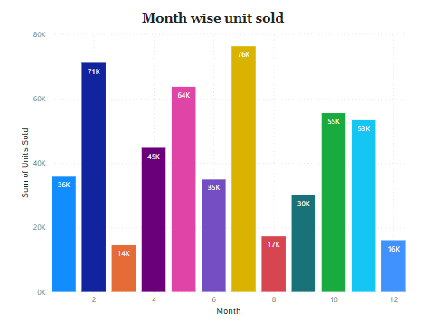
Month wise sales :-
We can see that in the months of February, may &June(2,5,7) are having higher sales
And in the month of march , August and December (3,8,12) are having lower sales

Slide 4
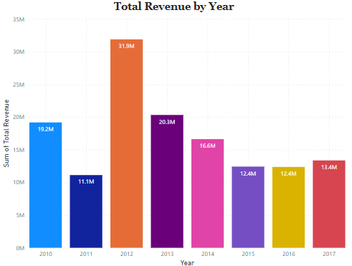
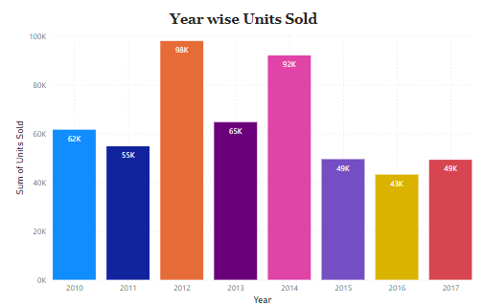
Yearly wise sales :-
2012 Has the highest revenue of 31.9M and the same year has highest unit sale of 98k

Slide 5
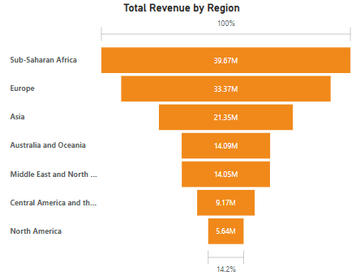
Total revenue by region :-
We can see that the hight revenue is in the sub-Saharan Africa followed by Europe
And the lowest revenue is from the north America

Slide 6
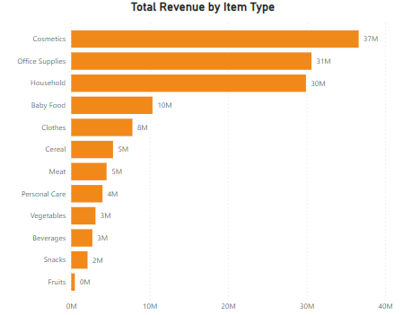
Total revenue by item type :-
We can say that cosmetics have the higher sales
And we have low sales of fruits

Slide 7
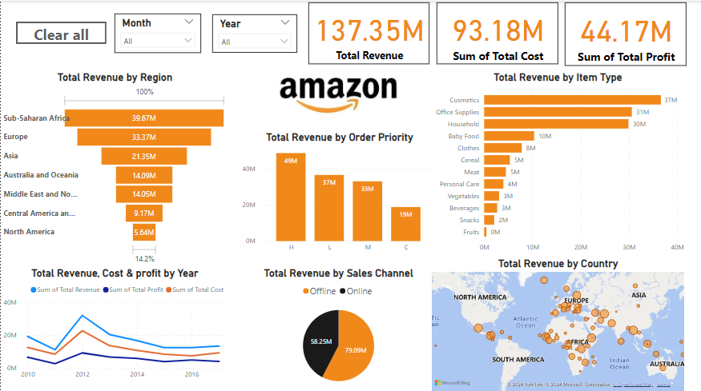
My Design :-

Slide 8
conclusion: :-
We can see that in the months of February, may &June(2,5,7) are having higher sales
And in the month of march , August and December (3,8,12) are having lower sales
2012 Has the highest revenue of 31.9M and the same year has highest unit sale of 98k
We can see that the hight revenue is in the sub-Saharan Africa followed by Europe
And the lowest revenue is from the north America
We can say that cosmetics have the higher sales
And we have low sales of fruits

Slide 9
Thank you

